Slide 1
Discrete Mathematics
Chapter 01
The Foundations: Logic and Proofs

Slide 2
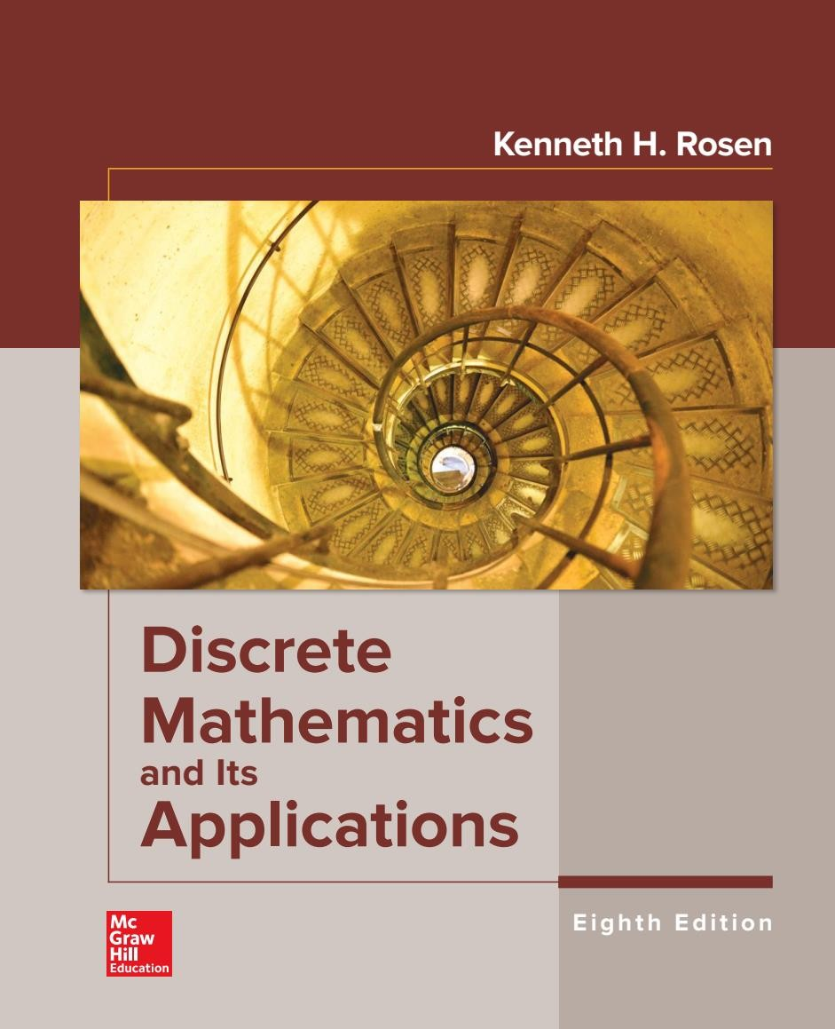
Lectures Reference

Slide 3
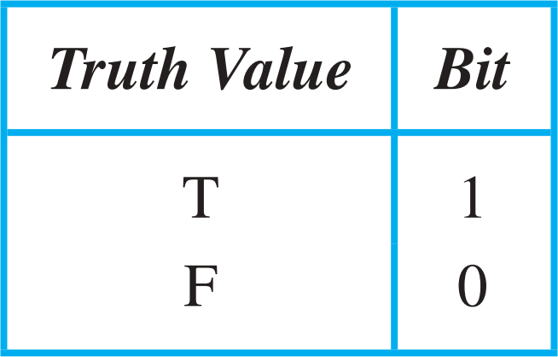
Compound Propositions
Logic and Bit Operations
Computers represent information using bits. A bit is a symbol with two possible values, namely, 0 (zero) and 1 (one).

Slide 4
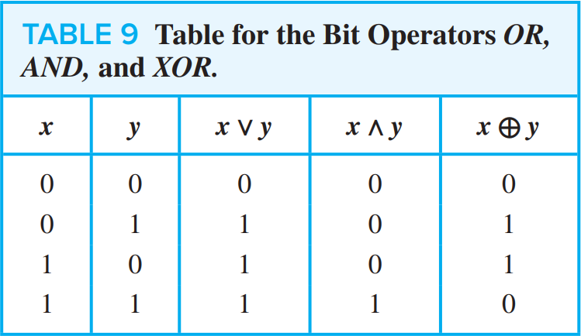
Compound Propositions (2)
Computer Bit Operations
We will also use the notation OR, AND, and XOR for the operators ∨, 𝖠, and ⊕, as is done in various programming languages.

Slide 5
Compound Propositions (3)
Bit Strings
Information is often represented using bit strings, which are lists of zeros and ones. When this is done, operations on the bit strings can be used to manipulate this information.

Slide 6
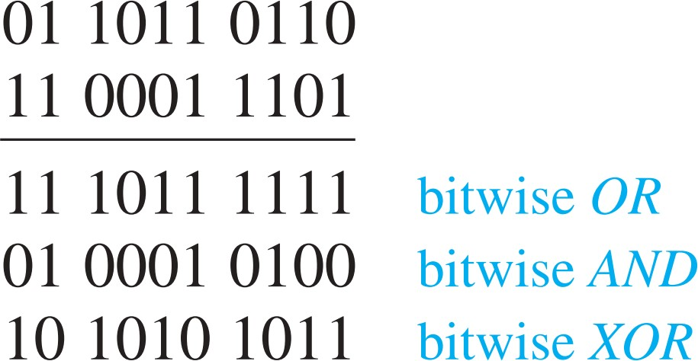
Compound Propositions (4)
Example
Find the bitwise OR, bitwise AND, and bitwise XOR of the bit strings 01 1011 0110 and 11 0001 1101

Slide 7
Applications of Propositional Logic (1/13)
1- Translating English Sentences. 2- System Specifications.
Boolean Searches.
Logic Puzzles.
Logic Circuits.

Slide 8
Applications of Propositional Logic (2/13)
Translating English Sentences
There are many reasons to translate English sentences into expressions involving propositional variables and logical connectives. In particular, English (and every other human language) is often ambiguous. Translating sentences into compound statements (and other types of logical expressions, which we will introduce later in this chapter) removes the ambiguity.

Slide 9
Applications of Propositional Logic (3/13)
Example 1
You can access the Internet from campus only if you are a computer science major or you are not a student.

Slide 10
Applications of Propositional Logic (4/13)
Example 1
You can access the Internet from campus only if you are a computer science major or you are not a student.
Let 𝑝, 𝑞 and 𝑟 be the propositions:
𝑝: You can access the Internet from campus.
𝑞: You are a computer science major.
𝑟: You are a student.

Slide 11
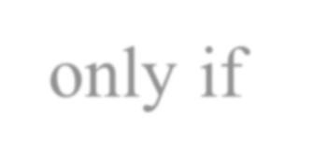
Applications of Propositional Logic (4/13)
Example 1
(You can access the Internet from campus) only if (you are a computer science major or you are not a student).
Let 𝑝, 𝑞 and 𝑟 be the propositions:
𝑝 → 𝑞
𝑝: You can access the Internet from campus.
𝑞: You are a computer science major.
𝑟: You are a student.

Slide 12
Applications of Propositional Logic (5/13)
Example 1
(You can access the Internet from campus) only if (you are a computer science major or you are not a student).
Let 𝑝, 𝑞 and 𝑟 be the propositions:
𝑝 → 𝑞
𝑝: You can access the Internet from campus.
𝑞: You are a computer science major.
𝑟: You are a student.
The sentence can be represented by logic as
𝑝 → (𝑞 ∨ ¬𝑟)

Slide 13
Applications of Propositional Logic (6/13)
Example 2
The automated reply cannot be sent when the file system is full.

Slide 14
Applications of Propositional Logic (7/13)
Example 2
The automated reply cannot be sent when the file system is full.
Let 𝑝 and 𝑞 be the propositions:
𝑝 → 𝑞
𝑝: The automated reply can be sent .
𝑞: The file system is full.

Slide 15
Applications of Propositional Logic (8/13)
Example 2
(The automated reply cannot be sent) when (the file system is full.)
Let 𝑝 and 𝑞 be the propositions:
𝑝 → 𝑞
𝑝: The automated reply can be sent .
𝑞: The file system is full.
The sentence can be represented by logic as
𝑞 → ¬𝑝

